Slide 1
Lecture 4 Data Visualization with ggplot2
Beckerman et al. p. 79-92

Slide 3
Visualization
You should do all your data visualization in ggplot2. Base R has much more control of small details but is also more complex in syntax.
Three most common figure types:
Scatter plot
Box and whisker plot
Histogram
Some people advocate abandoning bar charts/error bars
https://journals.plos.org/plosbiology/article?id=10.1371/journal.pbio.1002128

Slide 4
Lets make a graph
library(dplyr)
library(ggplot2)
compensation <- read.csv(“compensation.csv”)
ggplot(compensation, aes(x = Root, y = Fruit)) +
geom_point()
Notice that only a very small amount of code produces an OK looking graph
Open parentheses means no further parameters are defined; uses the defaults
aes() means ‘aesthetics’, the mapping between variables in the dataset and features of the graph.
ggplot2 works by adding layers and components to the aesthetic map; every new line of code is another layer.
Notes:
The empty parentheses () are what's known as a unit type, that is, a type that can only ever have a single value.

Slide 5
ggplot2
The aesthetics and data always form the first layer.
Then we add the geometric objects (geom) like points, lines, etc.
Lastly, we add/adjust other components, like x- and y-label customization
Notes:
The empty parentheses () are what's known as a unit type, that is, a type that can only ever have a single value.

Slide 6
Interpretation, Then Customize
How to quickly get rid of the grey background (default is theme_gray), how to alter the size of points and text, and how to make the colors correspond to the groups for the Grazing factor.
Themes are predefined sets of customizations (list here)
ggplot(compensation, aes(x = Root, y = Fruit)) +
geom_point() +
theme_bw()
Notes:
https://ggplot2.tidyverse.org/reference/ggtheme.html#ref-examples

Slide 7
Multiple Customizations
ggplot(compensation, aes(x = Root, y = Fruit, shape = Grazing, color = Grazing)) +
geom_point(size = 5) +
xlab("Root Biomass") +
ylab("Fruit Production") +
theme_bw()
Notes:
First 2 default colors and first 2 defaults for shapes
The empty parentheses () are what's known as a unit type, that is, a type that can only ever have a single value.
The default color scheme in ggplot2 i.e., scale_color_hue picks evenly spaced hues around the hcl (Hue-Chroma-Luminance) color wheel starting from 15.

Slide 8
Box-and-Whisker Plots
ggplot(compensation, aes(x = Grazing, y = Fruit)) +
geom_boxplot() +
xlab("Grazing treatment") +
ylab("Fruit Production") +
theme_bw()
ggplot(compensation, aes(x = Grazing, y = Fruit)) +
geom_boxplot() +
geom_point(size = 4, color = 'lightgrey', alpha = 0.5) +
xlab("Grazing treatment") +
ylab("Fruit Production") +
theme_bw()
Notes:
Only thing different is the addition of a point layer
Can make point layer ‘pink’
Alpha = transparency (0.5 = half transparent)

Slide 9
ggplot2 pre-defined colors
http://sape.inf.usi.ch/quick-reference/ggplot2/colour

Slide 10
RColorBrewer palettes: install.packages("RColorBrewer")
Notes:
http://www.sthda.com/english/wiki/colors-in-r

Slide 11
Distributions: Making Histograms
Plotting distribution of a single variable
ggplot(compensation, aes(x = Fruit)) +
geom_histogram()
Most obvious thing to adjust is bin width:
ggplot(compensation, aes(x = Fruit)) +
geom_histogram(bins = 10)
ggplot(compensation, aes(x = Fruit)) +
geom_histogram(binwidth = 15)
Notes:
The default number of bins in ggplot2 is 30 . You can modify the number of bins using the bins argument.

Slide 12
Faceting
Faceting, or latticing, is about producing a matrix of graphs, automatically structured by a factor (categorical variable) in your data.
This trick works for almost all graphics in ggplot2’s toolbox
Uses a special function called facet_wrap()
ggplot(compensation, aes(x = Fruit)) +
geom_histogram(binwidth = 15) +
facet_wrap(~Grazing)
Notes:
Noticed that ‘Fruit’ is now an X variable rather than defined as Y for X,Y plots.
Many great examples for the R for Data Science Chapter of Visualization

Slide 13
Saving Graphs
Plot Export Button:
provides options to save to image file types such as .png or .tiff, to save to PDF, or to copy the figure to the clipboard
Can adjust size, orientation, and define file path to save
ggsave() #Works by saving the figure in the plots window to a filename you specify; append filetype.
ggsave("ThatCoolHistogramOfFruit.png")
Saves to the current working directory; another reason to use Rstudio projects (already defined)
You can define the location, change the height and width, the units, filetype, and the resolution. All important if your work is to be fully repeatable.
?ggsave
Notes:
Noticed that ‘Fruit’ is now an X variable rather than defined as Y for X,Y plots.
Many great examples for the R for Data Science Chapter of Visualization

Slide 14
Ch. 8 Scales, Themes, Customizations

Slide 15
Ch. 8 Scales and Themes in ggplot2
library(gridExtra)
#a helper package for placing more than one ggplot2 figure on the same page
# Example scatterplot
eg_scatter <-
ggplot(data = compensation, aes(x = Root, y = Fruit)) +
geom_point()
# Example box-and-whiskers plot
eg_box <-
ggplot(data = compensation, aes(x = Grazing, y = Fruit)) +
geom_boxplot()
grid.arrange(eg_scatter, eg_box, nrow = 1) # try also ncol = 1

Slide 17
Things You May Want to Customize
• axis labels, with math symbols, rotation, and colors;
• axis ranges and tick mark locations;
• the grey background and the gridlines;
• the boxes and title in the legend;
• text annotation inside the plot.
Two routes to customizing a ggplot() figure.
The first is via a scale_() function.
The second is via the theme() function.

Slide 18
Axis Labels, Axis Limits, and Annotation
We can change the axis titles with xlab() and ylab(), or their parent function, labs(). They tell R to show these labels (make new layer) rather than the default X and Y mappings.
eg_scatter
eg_scatter +
xlab("Root Biomass") +
ylab("Fruit Production")
#re-scale the axes (x,y)
eg_scatter +
xlim(0, 20) +
ylim(0, 140)

Slide 19
Putting Custom Text Inside Figure
The annotate() function requires specifying the kind of annotation to use (e.g. ‘text), where to put the annotation using the coordinate system of the graph, and what to write—the label
eg_scatter +
annotate("text", x = c(6,8), y = c(105, 25),
label = c("Text up here...","...and text down here"))
Default for middle of text box positioned at coordinates

Slide 20
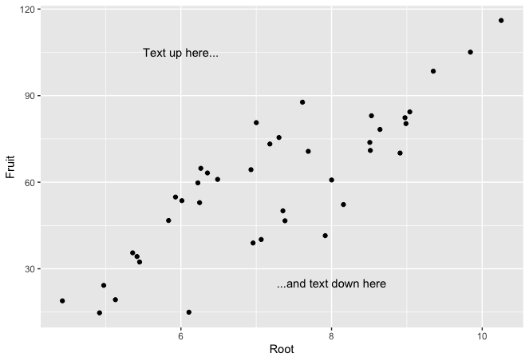
Putting Custom Text Inside Figure
Default is middle of text box positioned at coordinates

Slide 21
Scales
We adjust the range of the x-axis using the limits = argument, and the frequency and location of the tick marks by specifying the integer values where we want them with the breaks = argument
eg_scatter +
scale_x_continuous(limits = c(4, 11), breaks = 4:11)

Slide 22
Scales
We previously learned how to use the color = argument in aes() to allocate different colors to points based on their membership of a group.
We can extend this functionality by customizing the colors manually, using the scale_colour_manual() layering.
ggplot(data = compensation, aes(x = Root, y = Fruit, colour = Grazing)) +
geom_point() +
scale_colour_manual(values = c(Grazed = "brown", Ungrazed = "green"))
Notes:
Manual is always more flexible

Slide 23
Scales
Scale transformation; one or both of the X-Y axes
eg_box +
scale_y_continuous(breaks = seq(from = 10, to = 150, by = 20), trans = "log10")
Notes:
Manual is always more flexible

Slide 24
The Theme
Very powerful framework for adjusting all the non-aesthetic pieces of a graph; many built-in like theme_bw()
eg_scatter +
theme(
panel.background = element_rect(fill = NA, color = "black"),
panel.grid.minor = element_blank(),
panel.grid.major = element_line(color = "lightblue"))
Some of these are not intuitive, so it helps to have a reference list:
Notes:
Manual is always more flexible

Slide 25
Theme Elements
There is a sledgehammer of a tool, element_blank(), that shuts down the display of a panel component, as we have used for
panel.grid.minor = element_blank()
Theme element Type Description
axis.line segment line along axis
axis.text.x text x axis label
axis.text.y text y axis label
axis.ticks segment axis tick marks
axis.title.x text horizontal tick labels
axis.title.y text vertical tick labels
legend.background rect background of legend
legend.key rect background underneath legend keys
legend.text text legend labels
legend.title text legend name
panel.background rect background of panel
panel.border rect border around panel
panel.grid.major line major grid lines
panel.grid.minor line minor grid lines
plot.background rect background of the entire plot
plot.title text plot title
strip.background rect background of facet labels
strip.text.x text text for horizontal strips
strip.text.y text text for vertical strips
No need to remember these; look up elements as needed
Notes:
Table 8.1. from ggplot2 book (Wickham 2009)

Slide 26
The Theme
The panel group of theme elements have some logical names, like
‘background’ and ‘grid’, corresponding to clear features in a figure.
element_() specifies arguments for the panel group geometric components, such as ‘rect’ for ‘rectangle’ or ‘line’ for ‘lines’.
Each of these element_() arguments can be customized with now familiar (we hope) arguments such as fill = and colour =, as we have used via panel.background = element_rect(fill = NA, colour = "black").
element_blank(), that shuts down all rendering of a panel. component, as we have used for panel.grid.minor = element_blank().
Notes:
Manual is always more flexible

Slide 27
Some theme() Syntax for Axis Titles and Ticks
eg_box +
theme(
axis.title.x = element_text(colour = "cornflowerblue", size =rel(2)),
axis.text.x = element_text(angle = 45, size = 13, vjust = 0.5))
Notes:
For example, size =
can take an absolute size (e.g. 13) or a relative increase over the default,
using for example size = rel(2).

Slide 28
Discrete-Axis Customizations
Discrete axes, as in our boxplot example, delineate different groups of data according to the values of a categorical variable (factor or character vector).
We use the scale_x_discrete() or scale_y_discrete() function to customize the labelling of groups.
eg_box +
scale_x_discrete(limits = c("Ungrazed", "Grazed"), labels = c("Control", "Grazed"))
Notes:
Limits argument reverses scale
Recall that c( means collect in order

Slide 29
Legend Position
ggplot(compensation, aes(x = Root, y = Fruit, color = Grazing)) +
geom_point() +
theme(legend.position = "none")

Slide 30
Reference

Slide 31
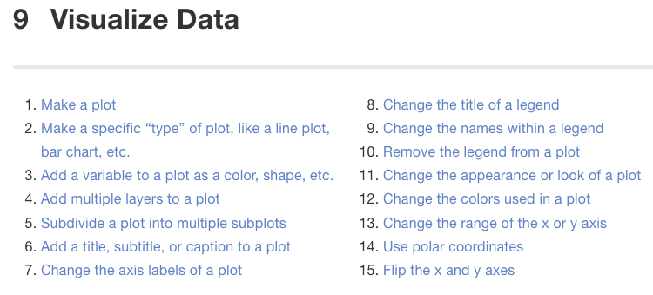
Good Reference Site for ggplot2:
https://rstudio-education.github.io/tidyverse-cookbook/visualize-data.html
Simple worked examples

